Slide 1
What is Progressive Enhancement?
Presented by Michael “Spell” Spellacy

Slide 2
What is Progressive Enhancement?
Progressive enhancement (or “PE” for short) is a web development strategy used to build sites with baseline devices in mind while layering in a richer experience for users with more modern browsers.
Notes:
Graceful Degradation: Examples of this are those pesky “You must have JavaScript or Flash support for this to work” messages.

Slide 3
But isn't that the same as Graceful Degradation?
Not quite. Graceful Degradation, also known as "fault tolerance“, allows a website to degrade in such a way that it continues to operate, but provides a reduced level of service rather than failing completely. (Examples of this are those pesky “You must have JavaScript or Flash support for this to work” messages.)
Progressive enhancement takes a different approach to development in that it seeks to create websites that are universally accessible to all by placing heavy emphasis on content and structure first and then building upon that in layers so that if one of those layers, like JavaScript, should fail, the site will still be accessible.
Notes:
Graceful Degradation: Examples of this are those pesky “You must have JavaScript or Flash support for this to work” messages or <noscript> tags

Slide 4
So how do we “progressively enhance” a website?
Separation of HTML, CSS and JavaScript are key to
building sites that work for everybody:
Begin with clear and well structured content. HTML is the foundation on which all else will be built.
Maintain rigid separation of layout and presentation with CSS.
Unobtrusively layer in advance behavior while carefully considering accessibility.
Let’s see an example…

Slide 5
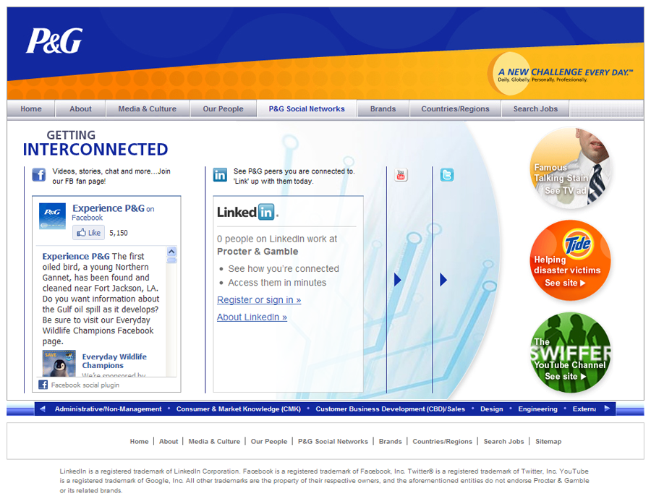
The Advanced Page
Here we have a page for P&G (http://experiencepg.com/social-networks.aspx) which contains advance JavaScript functionality that allows the end user to “slide” through different social widgets. This page should work well on all modern browsers.

Slide 6
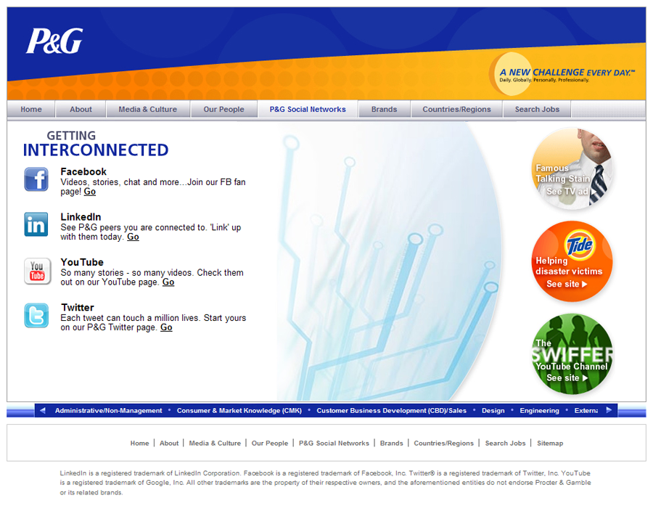
No JavaScript? No Problem!
This is the same exact page with JavaScript turned off. While not as advanced as the previous version, the message of this page is still left intact!

Slide 7
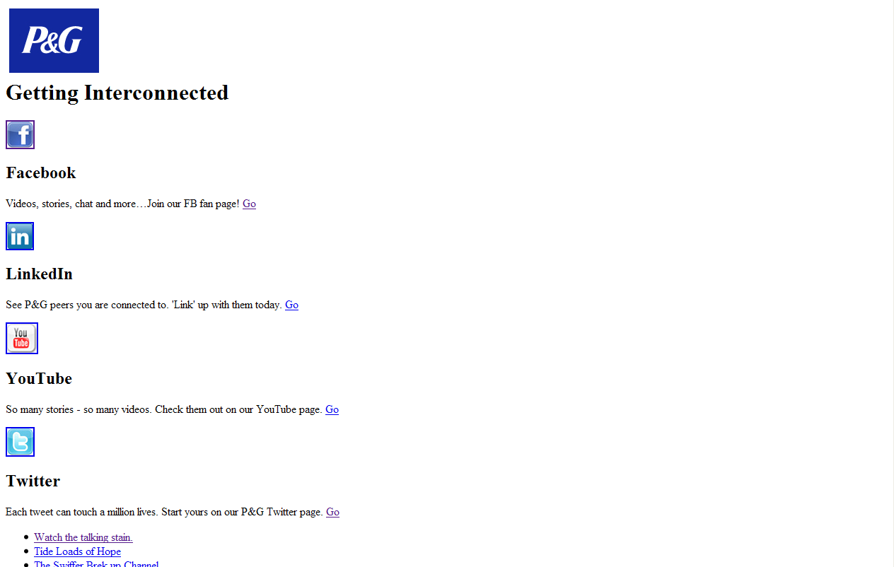
No CSS? No Problem!
We can even take it a step further and view the page without CSS. Because we’ve taken the time to lay a foundation down first with semantically and structurally sound HTML and then build from the ground up the page still retains it’s message! Screen readers, mobile users and search engines will also benefit. With Progressive Enhancement – everybody wins!**
** Everybody, that is, who still doesn’t insist upon having the same exact pixel perfect cross-browser experience!

Slide 8
Conclusion
We are no longer tied to our desktops. The ways in which people now access the web have changed drastically. Building with progressive enhancement at the forefront of our thoughts will allow us to create web sites that are compatible with different devices, easier to maintain and which can be accessed by everybody regardless of the browser they are using.

